Slide 1




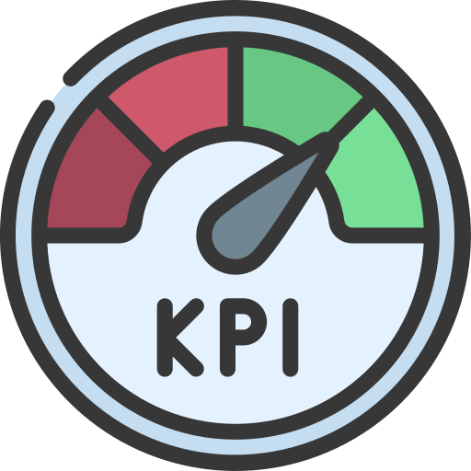
Data Analysis Portfolio Projects
- David Bhadana
Tools and Technique used:
Power BI, Advanced Excel, ETL (Export, Transform and Load), Data visualization, Data Cleaning, Pivot tables, VLookUp, DAX, Data Modelling, Measures, Power Query, Power Pivot

Slide 2
Index
Power BI
Clinical Trials KPI Dashboard
Electronics Sales Dashboard
Goods Sales Dashboard
Movies Data Analysis Dashboard
Models Analysis Dashboard
Movies Series Analysis Dashboard
Excel
Resourcing Report
Clinical Trial KPIs
E-commerce Sales Dashboard
Road Accidents Analysis
Electronics Sales Dashboard

Slide 3

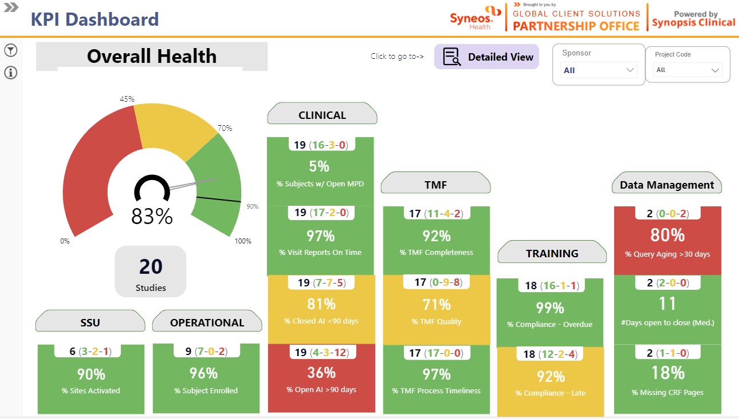
Clinical Trials KPI Dashboard – Power BI
Out of 19 projects for this KPI – 17 are green, 2 are amber and 0 red
This is the overall health %
Slicers
Total Projects in portfolio

Slide 4
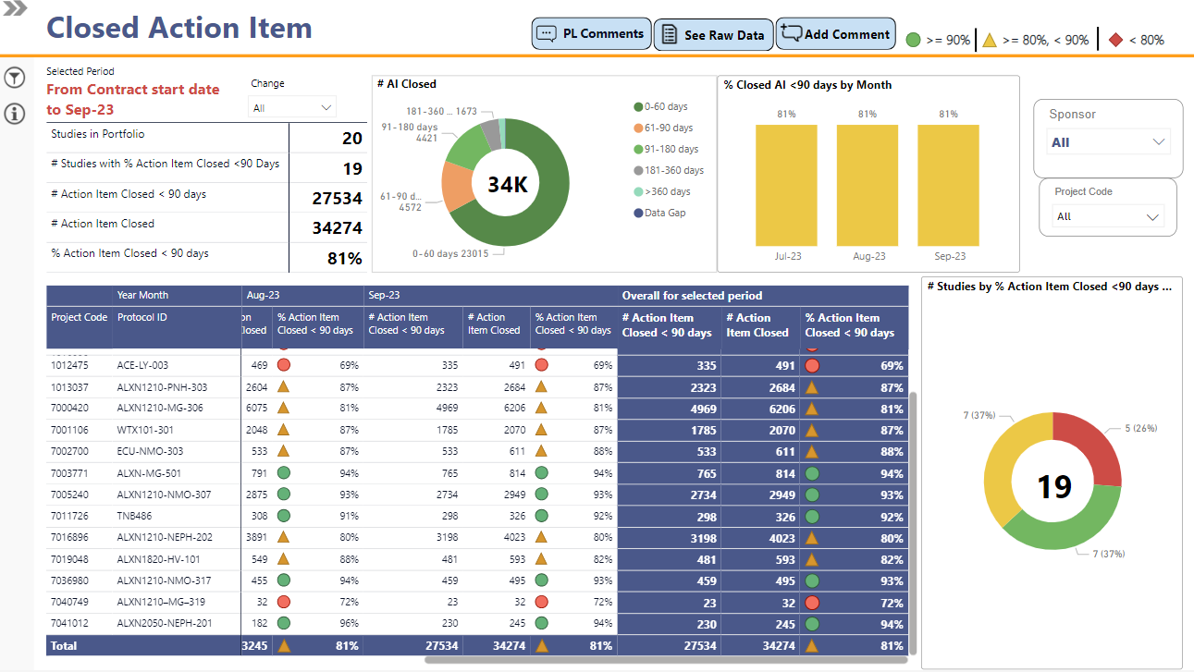
Summary
KPI Threshold
Monthly trend of KPI
Detailed view of KPI on Project level for last 3 months
Chart showing no. of red or green studies

Slide 5
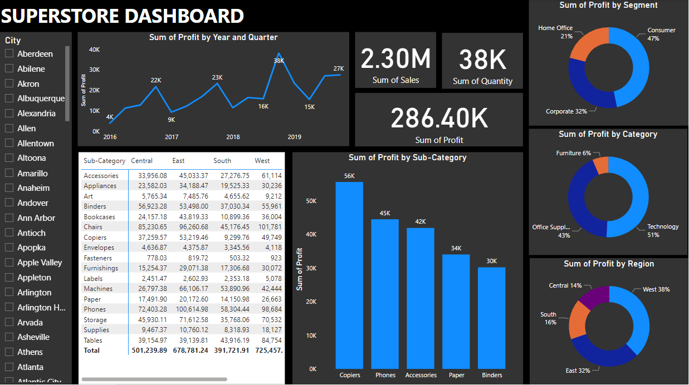
Electronics Sales Dashboard – Power BI

Slide 6
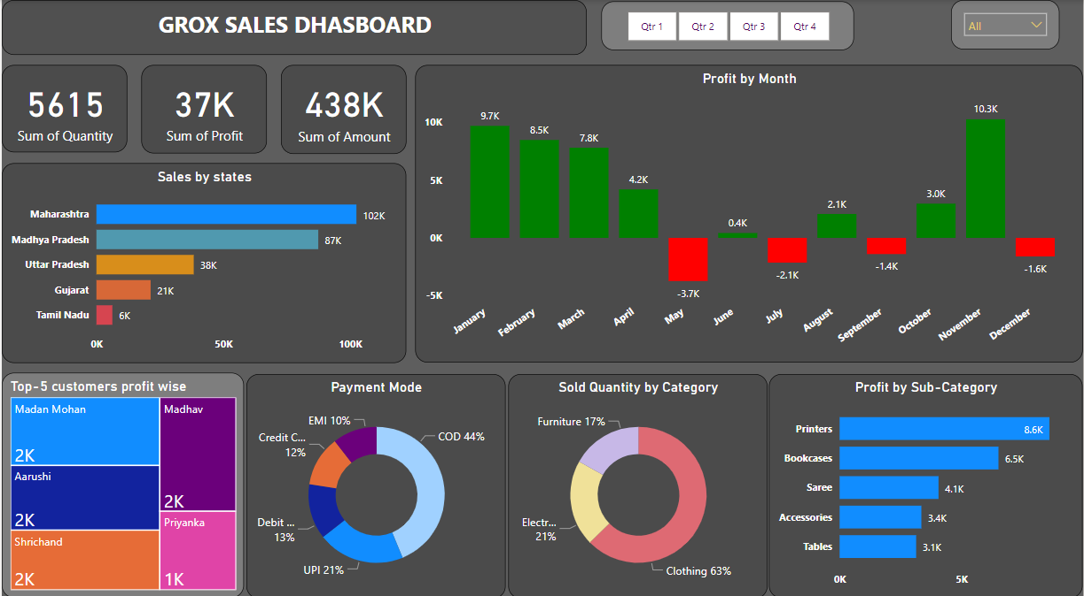
Goods Sales Dashboard – Power BI

Slide 7
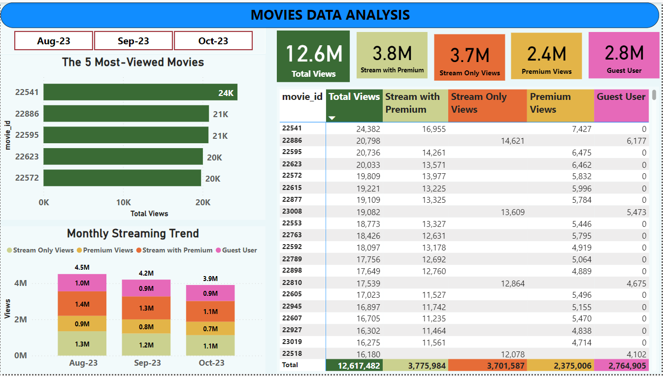
Movies Data Analysis Dashboard – Power BI

Slide 8
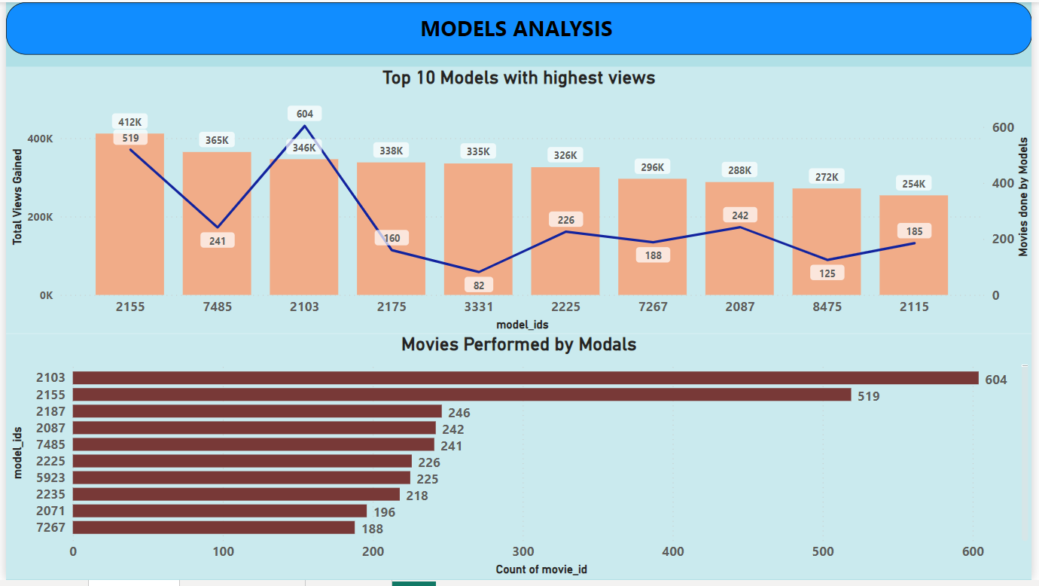
Models Analysis Dashboard – Power BI

Slide 9
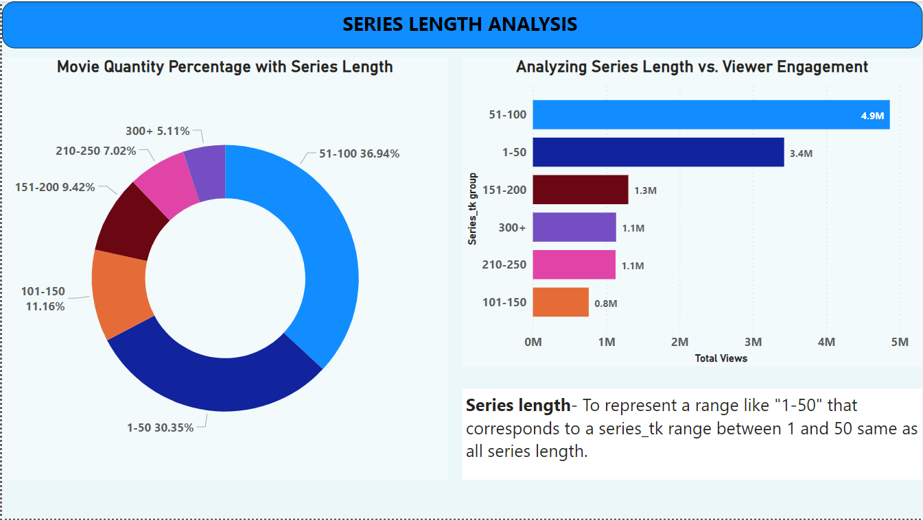
Movies Series Analysis Dashboard – Power BI

Slide 10
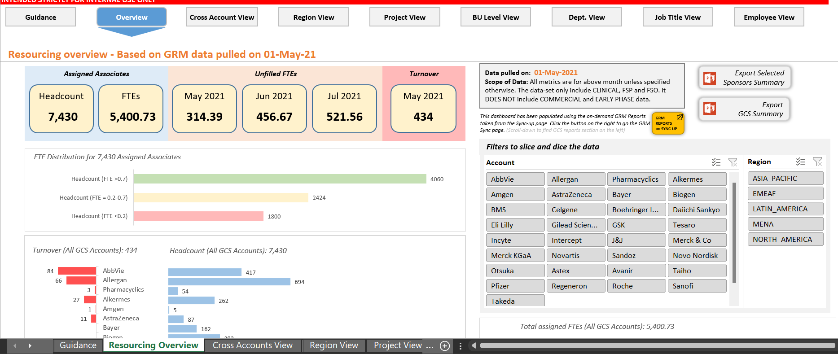
Resourcing Dashboard – Excel (1/2)
Navigation Bar
Account1
Account2
Account3
Account4
Account5
Account6
Account7
Account8
Account1
Headcount Chart
Account2
Account3
Turnover Chart
Account4
Account5
Account6
Account7
Account8

Slide 11
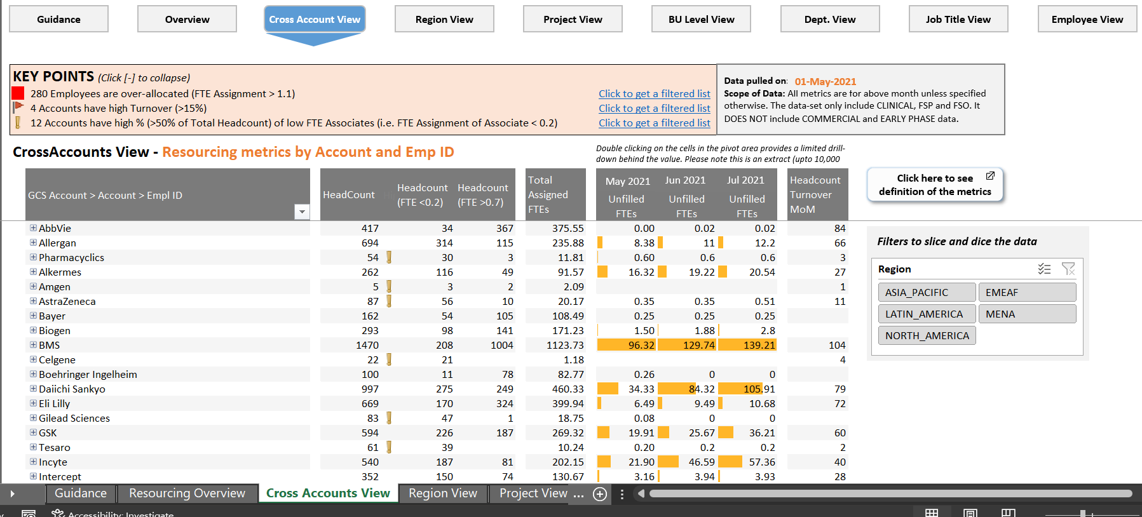
Resourcing Dashboard – Excel (2/2)
Summary
Account1
Account2
Account3
Detailed view of metrics on Account level
Account4
Slicer

Slide 12
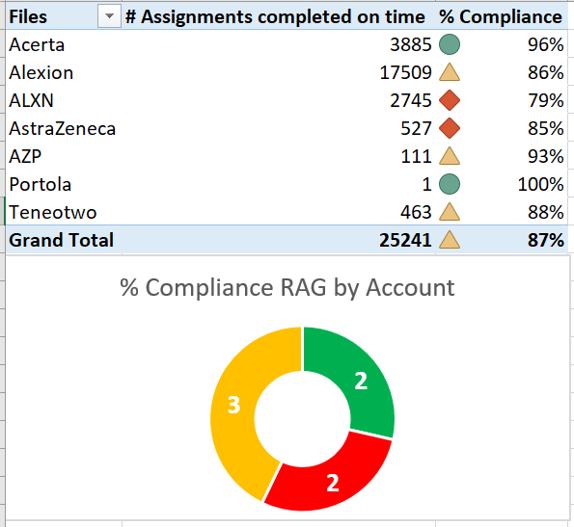
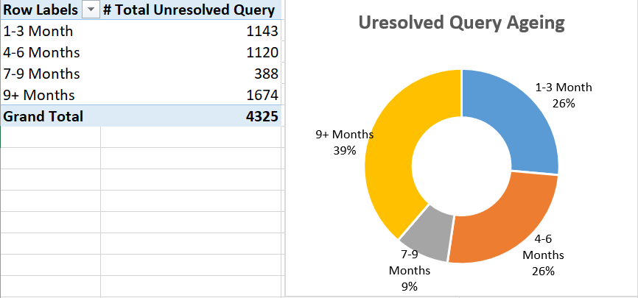
Clinical Trial KPIs – Excel
Account Level Training Compliance
Unresolved Query Ageing

Slide 13
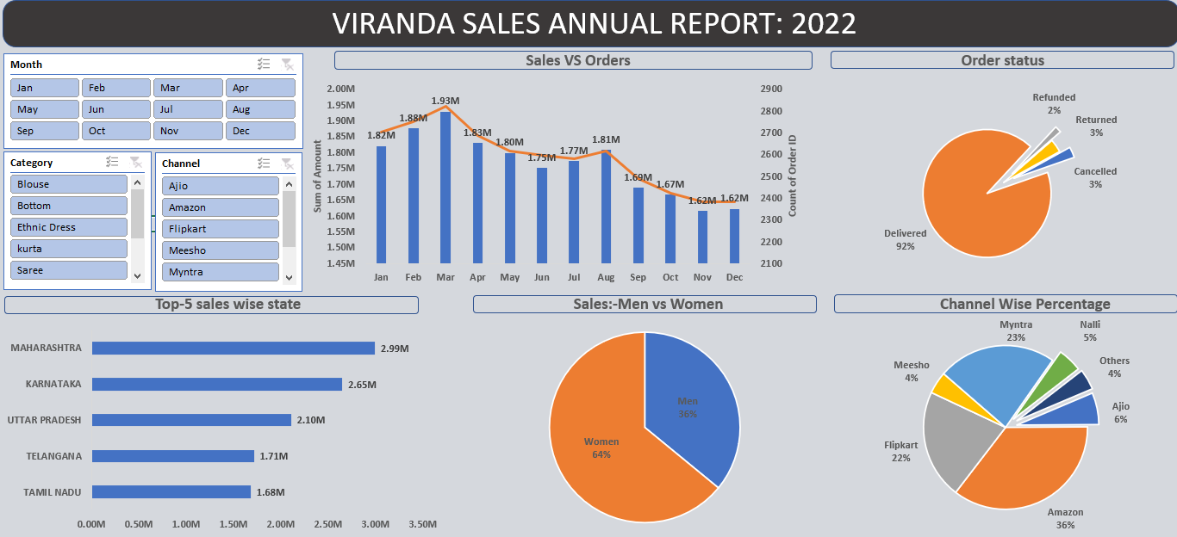
E-commerce Sales Dashboard – Excel

Slide 14
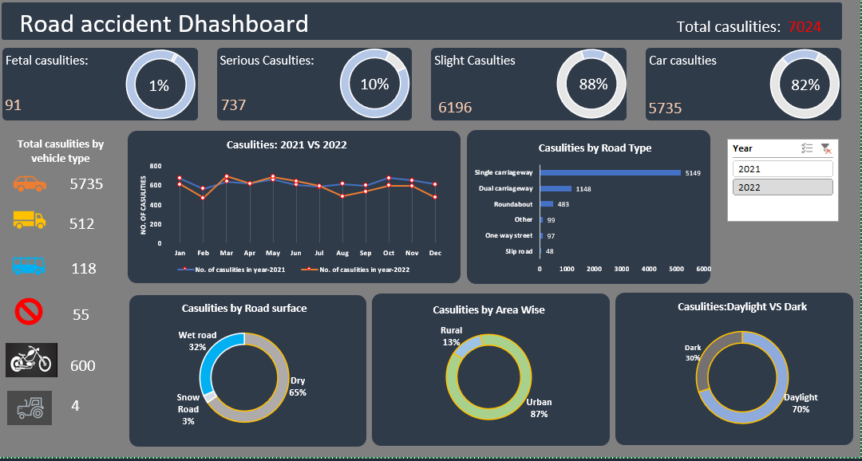
Road Accident Dashboard – Excel

Slide 15
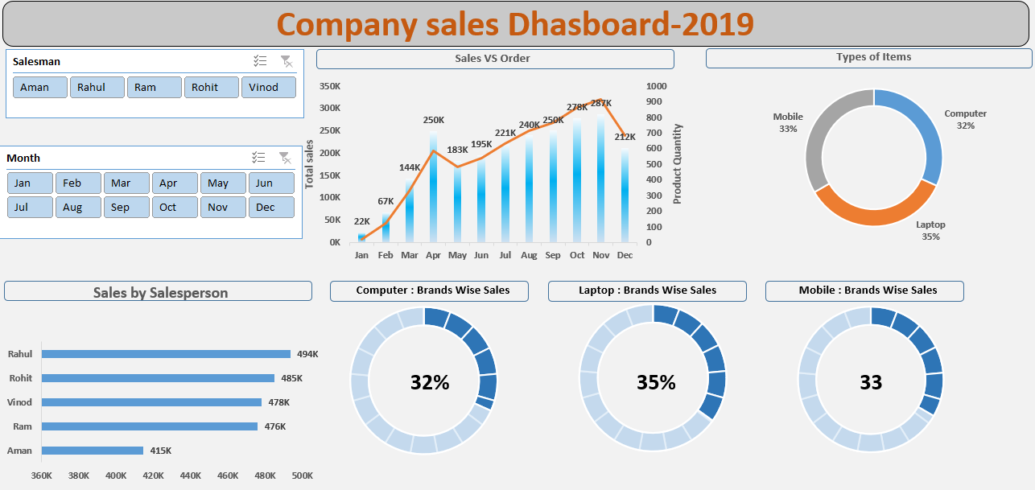
Electronics Sales Dashboard – Excel

Slide 16

Thank You!

